Slide 1
Introduction: Convolutional Neural Networks for Visual Recognition
boris .ginzburg@intel.com

Slide 2
Acknowledgments
This presentation is heavily based on:
http://cs.nyu.edu/~fergus/pmwiki/pmwiki.php
http://deeplearning.net/reading-list/tutorials/
http://deeplearning.net/tutorial/lenet.html
http://ufldl.stanford.edu/wiki/index.php/UFLDL_Tutorial
… and many other

Slide 3
Agenda
Course overview
Introduction to Deep Learning
Classical Computer Vision vs. Deep learning
Introduction to Convolutional Networks
Basic CNN Architecture
Large Scale Image Classifications
How deep should be Conv Nets?
Detection and Other Visual Apps
Notes:
Consider outlining your agenda verbally. May not need an agenda for 8 slides

Slide 4
Course overview
Introduction
Intro to Deep Learning
Caffe: Getting started
CNN: network topology, layers definition
CNN Training
Backward propagation
Optimization for Deep Learning: SGD : monentum, rate adaptation, Adagrad, SGD with Line Search, CGD
“Regularization” (Dropout , Maxout)

Slide 5
Course overview
Localization and Detection
Overfeat
R-CNN (Regions with CNN)
CPU / GPU performance optimization
CUDA
Vtune, OpenMP, and Intel MKL (Math Kernel Library)

Slide 6
Introduction to Deep Learning

Slide 7
Buzz…

Slide 8

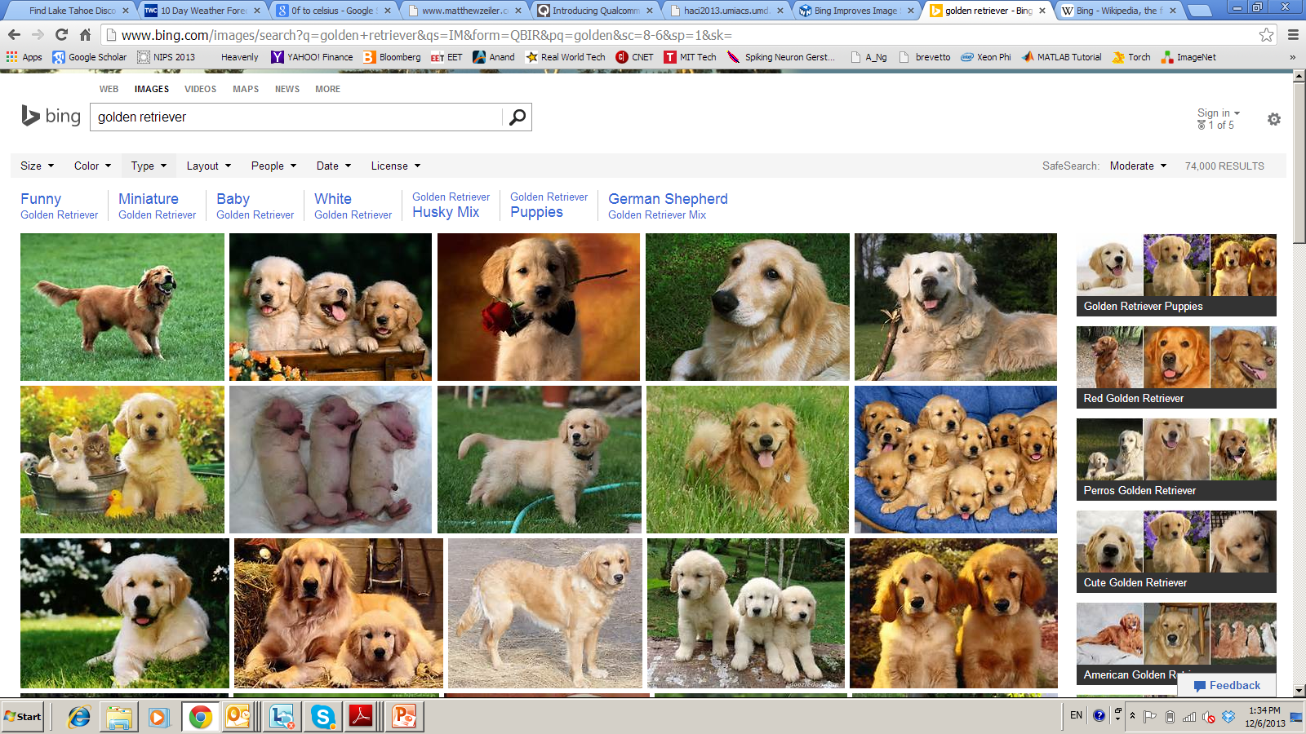


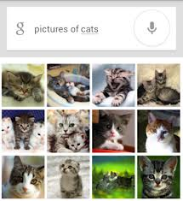

Deep Learning – from Research to Technology
Deep Learning - breakthrough in visual and speech recognition

Slide 9
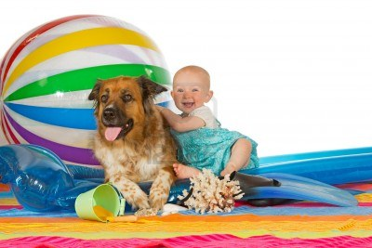
Classical Computer Vision Pipeline

Slide 10
Classical Computer Vision Pipeline.
CV experts
Select / develop features: SURF, HoG, SIFT, RIFT, …
Add on top of this Machine Learning for multi-class recognition and train classifier
Feature
Extraction:
SIFT, HoG...
Detection,
Classification
Recognition
Classical CV feature definition is domain-specific and time-consuming

Slide 11
Deep Learning –based Vision Pipeline.
Deep Learning:
Build features automatically based on training data
Combine feature extraction and classification
DL experts: define NN topology and train NN
Deep NN...
Deep NN...
Detection,
Classification
Recognition
Deep Learning promise:
train good feature automatically,
same method for different domain

Slide 12
Computer Vision +Deep Learning + Machine Learning
We want to combine Deep Learning + CV + ML
Combine pre-defined features with learned features;
Use best ML methods for multi-class recognition
CV+DL+ML experts needed to build the best-in-class
CV
features
HoG, SIFT
Deep
NN...
ML
AdaBoost
…
Combine best of Computer Vision
Deep Learning and Machine Learning

Slide 13
Deep Learning Basics
Deep Learning – is a set of machine learning algorithms based on multi-layer networks
CAT
DOG
OUTPUTS
HIDDEN
NODES
INPUTS

Slide 14

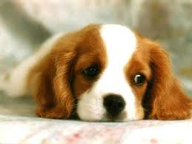
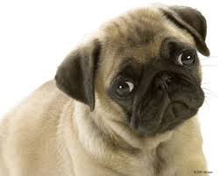
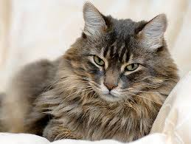
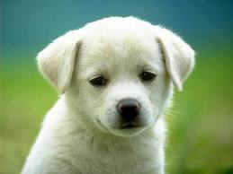

Deep Learning Basics
Deep Learning – is a set of machine learning algorithms based on multi-layer networks
CAT
DOG
Training

Slide 15
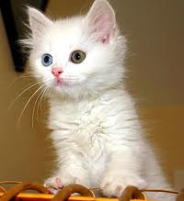
Deep Learning Basics
Deep Learning – is a set of machine learning algorithms based on multi-layer networks
CAT
DOG

Slide 16
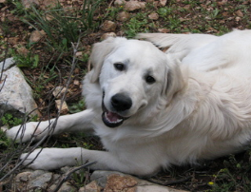
Deep Learning Basics
Deep Learning – is a set of machine learning algorithms based on multi-layer networks
CAT
DOG

Slide 17
Deep Learning Taxonomy
Supervised:
Convolutional NN ( LeCun)
Recurrent Neural nets (Schmidhuber )
Unsupervised
Deep Belief Nets / Stacked RBMs (Hinton)
Stacked denoising autoencoders (Bengio)
Sparse AutoEncoders ( LeCun, A. Ng, )

Slide 18
Convolutional Networks

Slide 19
Convolutional NN
Convolutional Neural Networks is extension of traditional Multi-layer Perceptron, based on 3 ideas:
Local receive fields
Shared weights
Spatial / temporal sub-sampling
See LeCun paper (1998) on text recognition:
http://yann.lecun.com/exdb/publis/pdf/lecun-01a.pdf

Slide 20
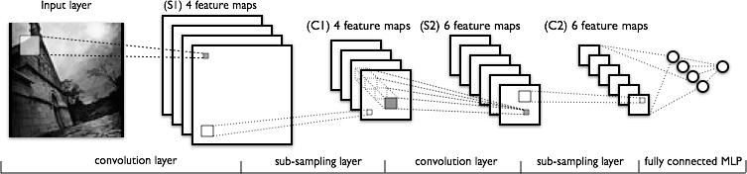
What is Convolutional NN ?
CNN - multi-layer NN architecture
Convolutional + Non-Linear Layer
Sub-sampling Layer
Convolutional +Non-L inear Layer
Fully connected layers
Supervised
Feature Extraction
Classi-
fication

Slide 21

What is Convolutional NN ?
2x2
Convolution + NL
Sub-sampling
Convolution + NL

Slide 22

CNN success story: ILSVRC 2012
Imagenet data base: 14 mln labeled images, 20K categories

Slide 23
ILSVRC: Classification

Slide 24
Imagenet Classifications 2012

Slide 25
ILSVRC 2012: top rankers
http://www.image-net.org/challenges/LSVRC/2012/results.html
N | Error-5 | Algorithm | Team | Authors
1 | 0.153 | Deep Conv. Neural Network | Univ. of Toronto | Krizhevsky et al
2 | 0.262 | Features + Fisher Vectors + Linear classifier | ISI | Gunji et al
3 | 0.270 | Features + FV + SVM | OXFORD_VGG | Simonyan et al
4 | 0.271 | SIFT + FV + PQ + SVM | XRCE/INRIA | Perronin et al
5 | 0.300 | Color desc. + SVM | Univ. of Amsterdam | van de Sande et al

Slide 26
Imagenet 2013: top rankers
http://www.image-net.org/challenges/LSVRC/2013/results.php
N | Error-5 | Algorithm | Team | Authors
1 | 0.117 | Deep Convolutional Neural Network | Clarifi | Zeiler
2 | 0.129 | Deep Convolutional Neural Networks | Nat.Univ Singapore | Min LIN
3 | 0.135 | Deep Convolutional Neural Networks | NYU | Zeiler Fergus
4 | 0.135 | Deep Convolutional Neural Networks |  | Andrew Howard
5 | 0.137 | Deep Convolutional Neural Networks | Overfeat NYU | Pierre Sermanet et al

Slide 27
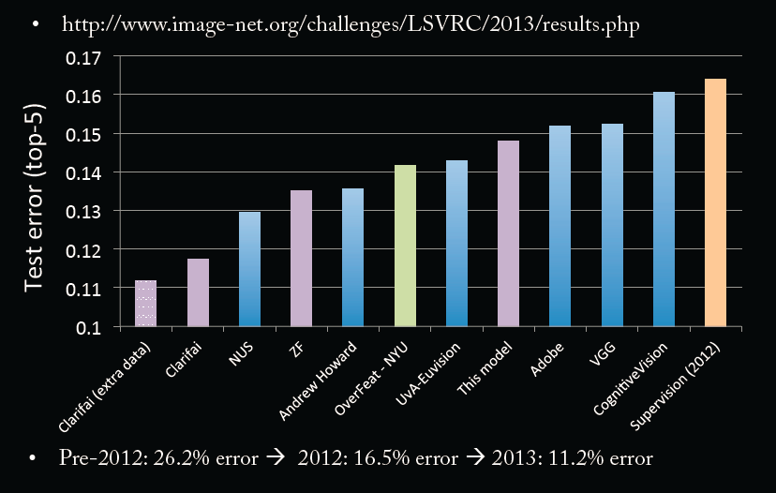
Imagenet Classifications 2013

Slide 28
Conv Net Topology
5 convolutional layers
3 fully connected layers + soft-max
650K neurons , 60 Mln weights

Slide 29
Why ConvNet should be Deep?
Rob Fergus, NIPS 2013

Slide 30
Why ConvNet should be Deep?

Slide 31
Why ConvNet should be Deep?

Slide 32
Why ConvNet should be Deep?

Slide 33
Why ConvNet should be Deep?

Slide 34
Conv Nets: beyond Visual Classification

Slide 35

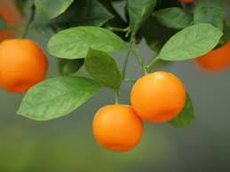
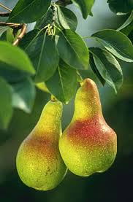
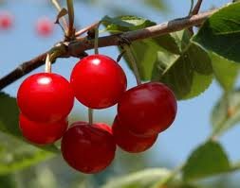
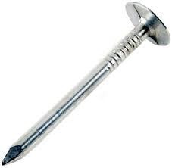
CNN applications
CNN is a big hammer
Plenty low hanging fruits
You need just a right nail!

Slide 36
Conv NN: Detection
Sermanet, CVPR 2014

Slide 37
Conv NN: Scene parsing
Farabet, PAMI 2013

Slide 38
CNN: indoor semantic labeling RGBD
Farabet, 2013

Slide 39
Conv NN: Action Detection
Taylor, ECCV 2010

Slide 40
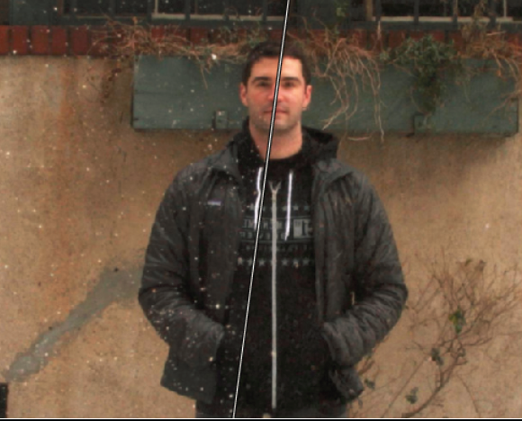
Conv NN: Image Processing
Eigen , ICCV 2010

Slide 41
BUZZ
BACKUP

Slide 42
A lot of buzz about Deep Learning
July 2012 - Started DL lab
Nov 2012- Big improvement in Speech, OCR:
Speech – reduce Error Rate by 25%
OCR – reduce Error rate by 30%
2013 launched 5 DL based products
Voice search
Photo Wonder
Visual search

Slide 43
A lot of buzz about Deep Learning
Microsoft On Deep Learning for Speech goto 3:00-5:10

Slide 44
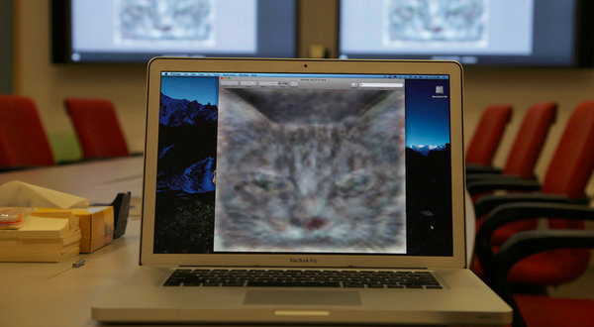
A lot of buzz about Deep Learning
Why Google invest in Deep Learning

Slide 45


A lot of buzz about Deep Learning
NYU “Deep Learning” Professor LeCun Will Head Facebook’s New Artificial Intelligence Lab, Dec 10, 2013

